Slide 1
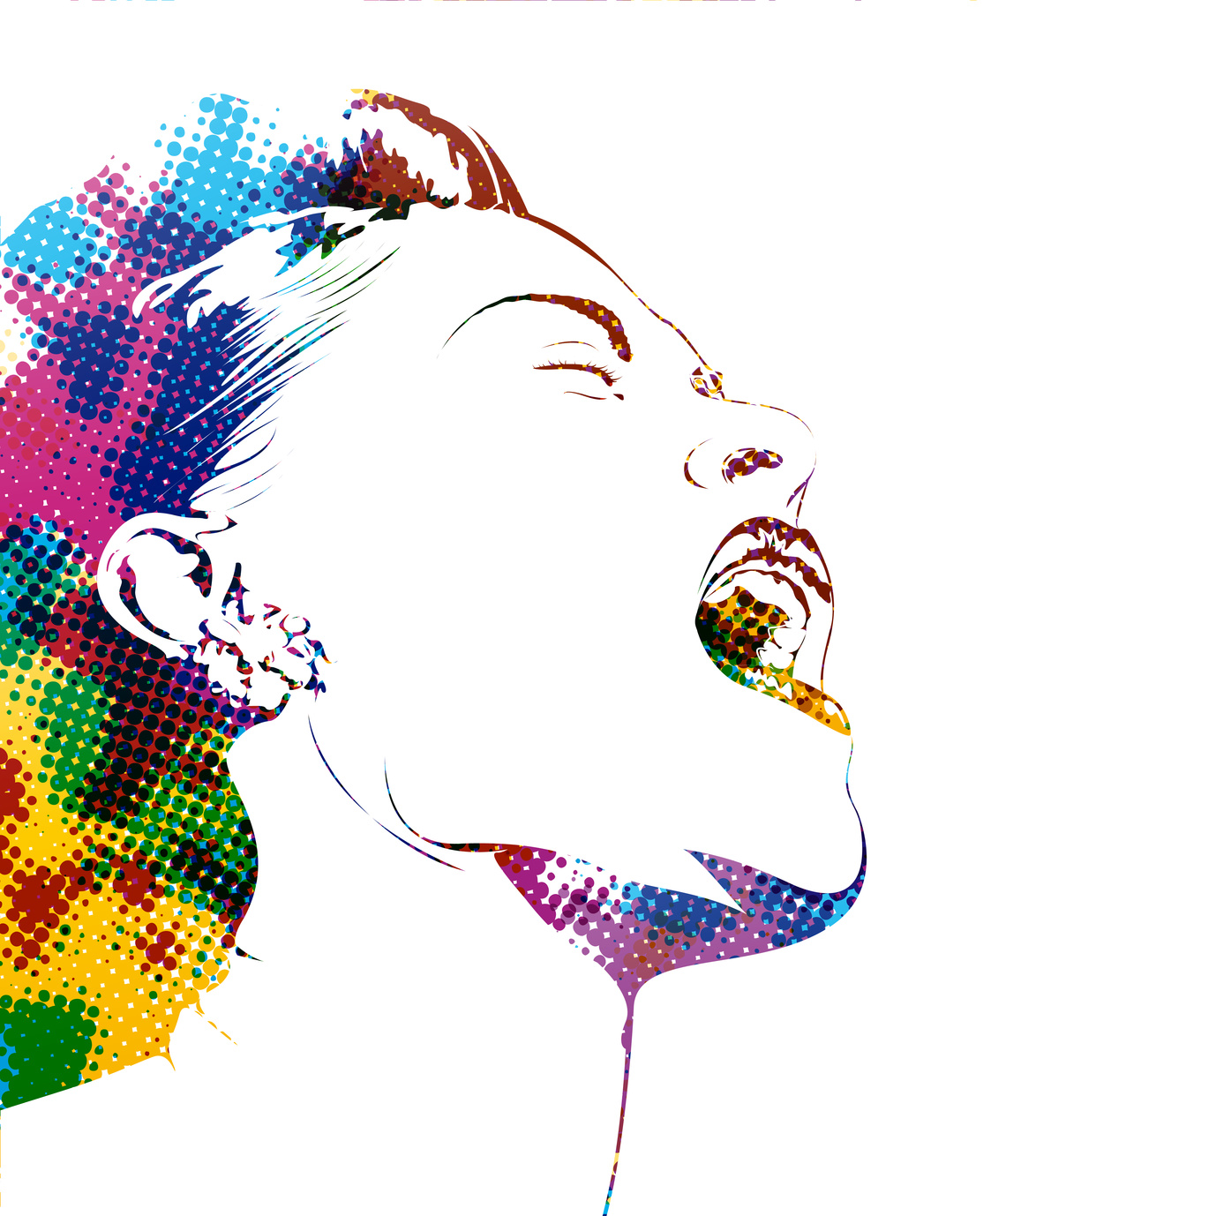
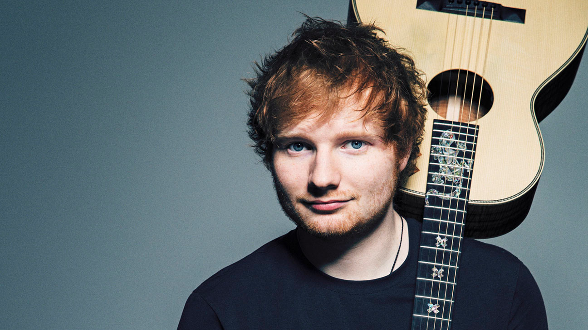
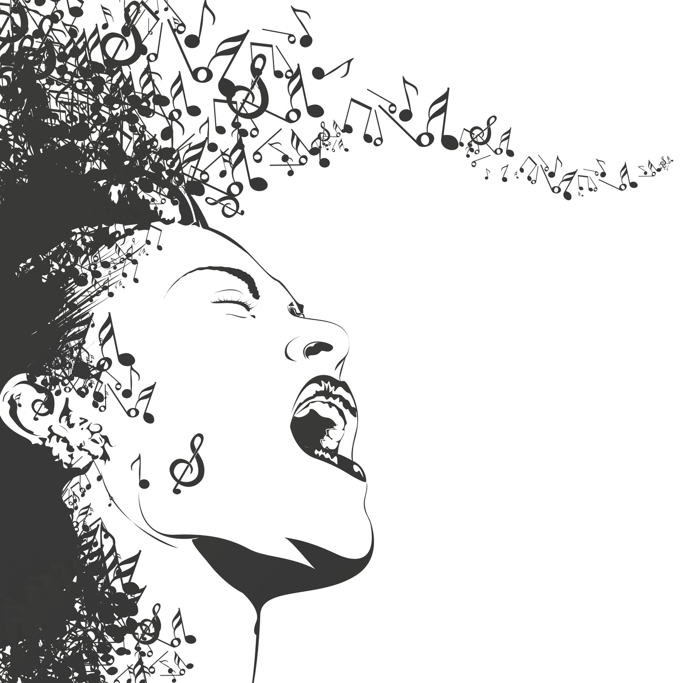
Ed Sheeran
gehört zum Shop-Produkt English Music / schularena.com

Slide 2
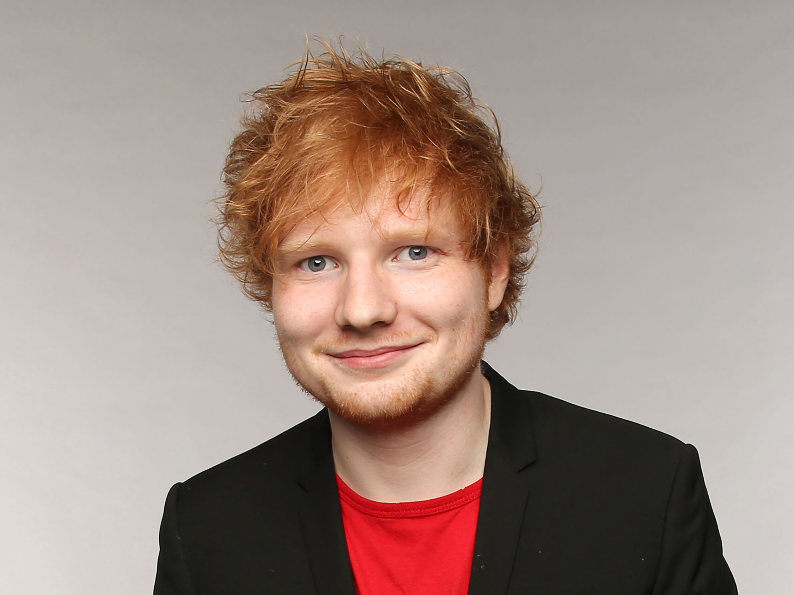
Profile Ed Sheeran
Date of birth: 17th February 1991
Real name: Edward Christopher Sheeran
Born in: Halifax, West Yorkshire (England)
Years active: 2004 - present
girlfriend: Cherry Seaborn (childhood friend)
Family situation: not married, no children
Most successful title: Shape of you
Sold recording mediums: 92 million

Slide 3
What‘s more …
His older brother, Matthew is a composer of classical music.
Ed Sheeran began to record his own songs at a very young age (14).
His debut album (not including self-released records) was called +.
Ed performed at the closing ceremony of the 2012 Summer Olympics in London.
Eminem is Ed Sheeran’s favourite rapper.
Ed is now teetotal (he doesn’t drink alcohol any more).
He loves building LEGO sets, and he celebrated his album (+) going to number one in the charts by building a LEGO Star Wars Millennium Falcon.

Slide 4
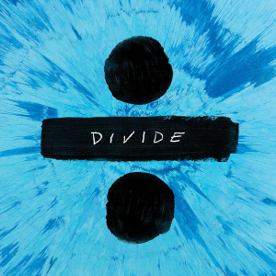
Galway Girl
From the album: ÷ Divide (2017)
According to Sheeran, he had to fight his record label to keep the song on his album: "They were really, really against Galway Girl, because apparently folk music isn't cool.“
The song was made up and not about anyone in particular.

Slide 5
Video on YouTube
https://www.youtube.com/watch?v=87gWaABqGYs

